Slide 1
Introduction to hypervisor

Slide 2
Type of Hypervisor
Virtualization Basic
Type 1 hypervisor: hypervisors run directly on the system hardware – A “bare metal” embedded hypervisor
QNX (QNX)
Multivisor (Greenhills)
Coqos (OpenSynergy)
Type 2 hypervisor: hypervisors run on a host operating system that provides virtualization services, such as I/O device support and memory management.
VMware Server
Oracle VM VirtualBox
KVM

Slide 3
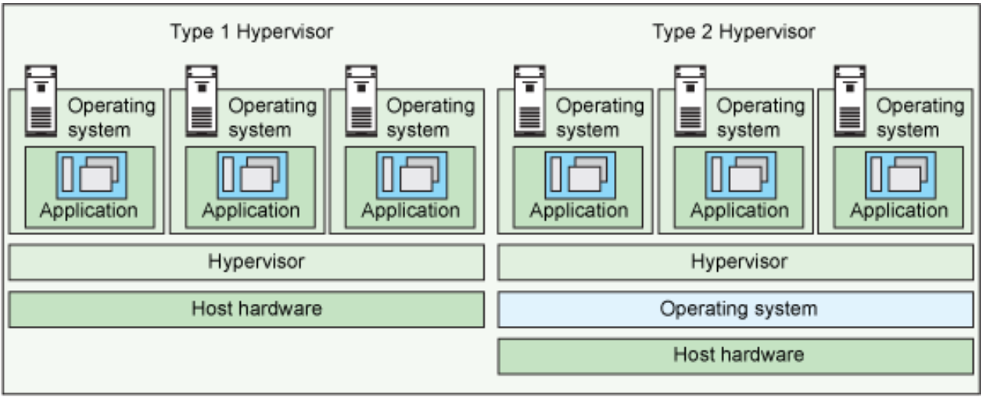
Type of Hypervisor
Virtualization Basic
Host OS on which hypervisor runs

Slide 4
Fullvirtualization vs. Paravirtualization
Virtualization Basic
In paravirtualization, the guest operating system is not only aware that it is running on a hypervisor but includes code to make guest-to-hypervisor transitions more efficient
QNX (QNX)
Multivisor (Greenhills)
Coqos (OpenSynergy)
In full virtualization, the guest operating system runs on top of a hypervisor that sits on the bare metal. The guest is unaware that it is being virtualized and requires no changes to work in this configuration
VMware Server
Oracle VM VirtualBox
KVM

Slide 5
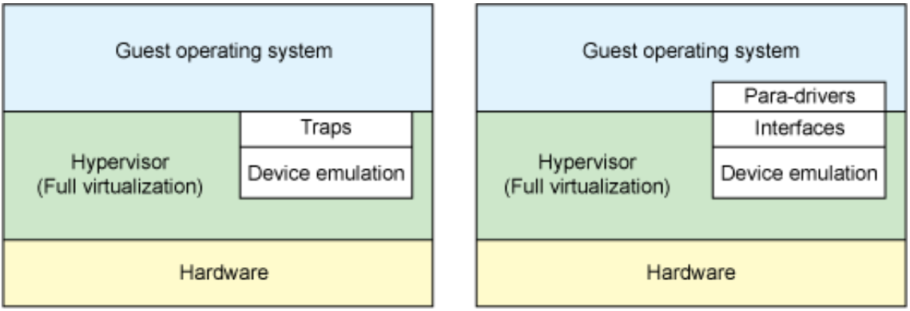
Fullvirtualization vs. Paravirtualization
Virtualization Basic
Modification to Guest OS
Para virtualization

Slide 6





Comparison and Conclusion
Virtualization Basic
Overhead
Vmware
Virtualbox
Type-2
KVM
Type-1
Multivisor
QNX
Coqos
Performance
Full virtualization
Para virtualization

Slide 7
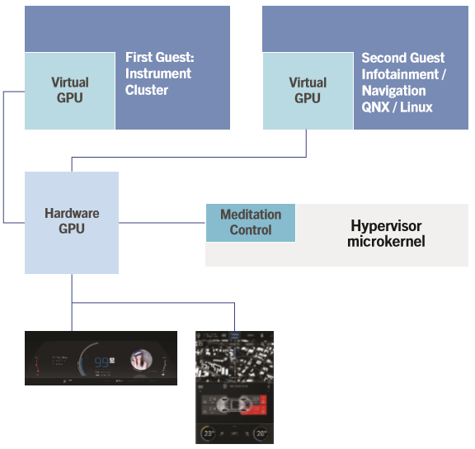
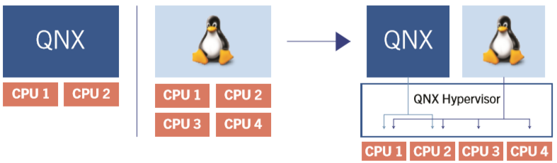
Sharing by HW Virtualization
Device Handling
Single physical device is shared by multi-guest OSes
The physical device support HW virtualization
Hypervisor control the sharing of device by taking advantage of HW capacity
GPU sharing
CPU sharing

Slide 8
Sharing by Front-End/Back-End
Device Handling
RTOS
ANDROID OS
Graphic commands from Android OS are send by the FE (Front End) to BE server (Back End)
Shared memory is used to store Graphic command chunk (no VM context switch needed ⇨ no performance overhead)
Events used to draw prepared chunk. (VM context switch => performance overhead )
Modified GLES/EGL is provided by Qualcomm
KGSL server receives the Graphic commands and sends on behalf of other GPU contexts to GPU core.
UGSL - User Graphic Shared Library
KGSL- Kernel Graphic Shared Library
ESX – Enhanced Shared Graphix
RTOS Applications
Android Applications
ESX (w/ EGL)
ESX (w/ EGL)
UGSL
UGSL
Front End
Back End Server
KGSL Server
Linux Kernel
Hypervisor
SoC (Application Processor)
Shared Memory
GPU
Priority controller and context switch
IOMMU
Memory

Slide 9
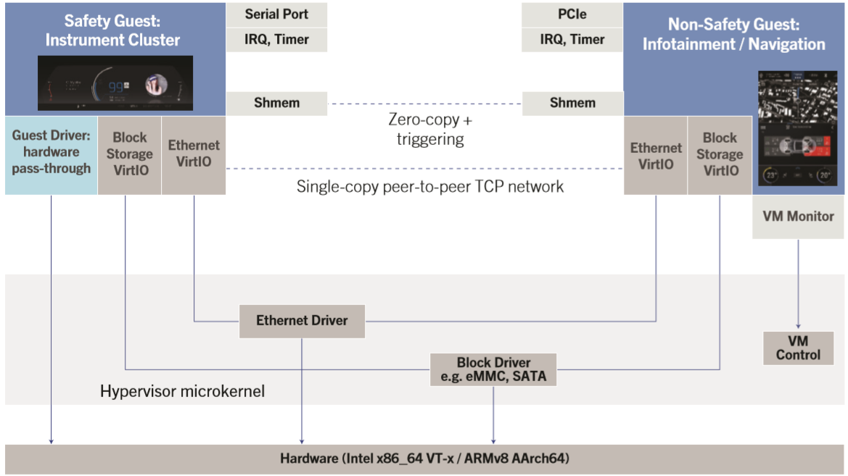
Sharing by VirtIO (Special type of Front End/Back End)
Device Handling
Single physical device is shared by multi-guest OSes
The physical device doesn’t support HW virtualization
Hypervisor simulates virtual device that can be shared by mulit-guest OSes with virtIO technology
The virtual device can be emulated in hypervisor, in dedicated guest OS, or in specified guest OS

Slide 10
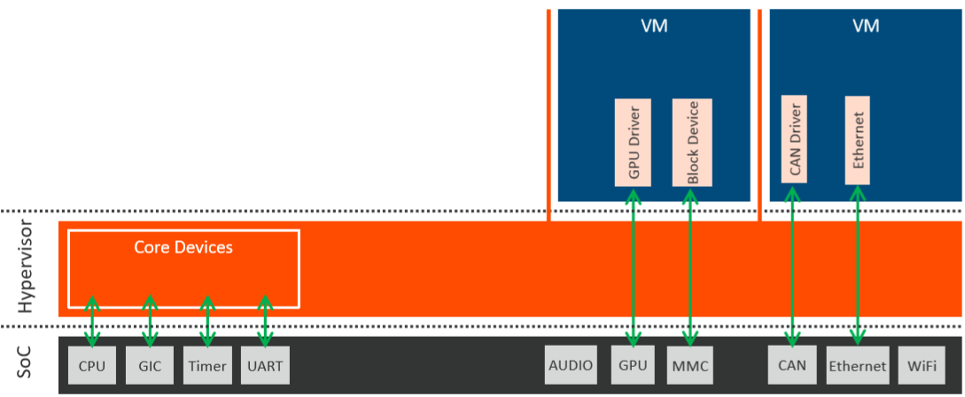
Pass-through
Device Handling
Devices are not shared. They are exclusively occupied by single guest OS.
Hypervisor just pass-through access from guest OS to devices. The performance is similar to direct access from native OS.

Slide 11
Comparison and Conclusion
Device Handling
 | Performance | HW Support | Sharable | Hypervisor
HW Virtualization | ☆☆☆☆ | required | yes | QNX, Multivisor, Coqos
Fron tEnd/Back End | ☆☆☆ | no | yes | QNX, Multivisor, Coqos
VirtIO | ☆☆☆ | no | yes | QNX, Multivisor, Coqos
Pass-through | ☆☆☆☆☆ | no | no | QNX, Multivisor, Coqos

Slide 12
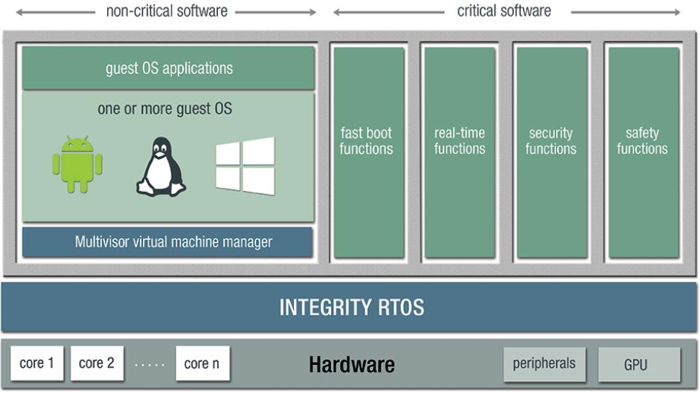
Hypervisor as RTOS: QNX and Multivisor
Guest RTOS
The hypervisor itself is a RTOS
It combines general purpose guest OS with critical software running at the RTOS
No extra guest OS is required to run the critical software

Slide 13
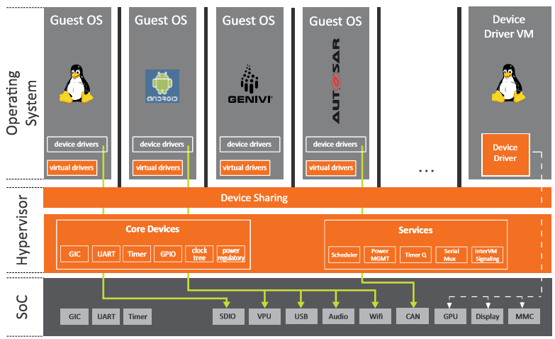
Hypervisor without RTOS: Coqos (Opensynergy)
Guest RTOS
Dedicated RTOS to run critical software
Hypervisor is only responsible for virtualization; no RTOS is provided
All functions runs in guest OS. This means to run critical software, an extra guest RTOS is required.
Coqos doesn’t support Integrity OS and QNX. But there are other RTOS running as guest OS for critical functions.

Slide 14
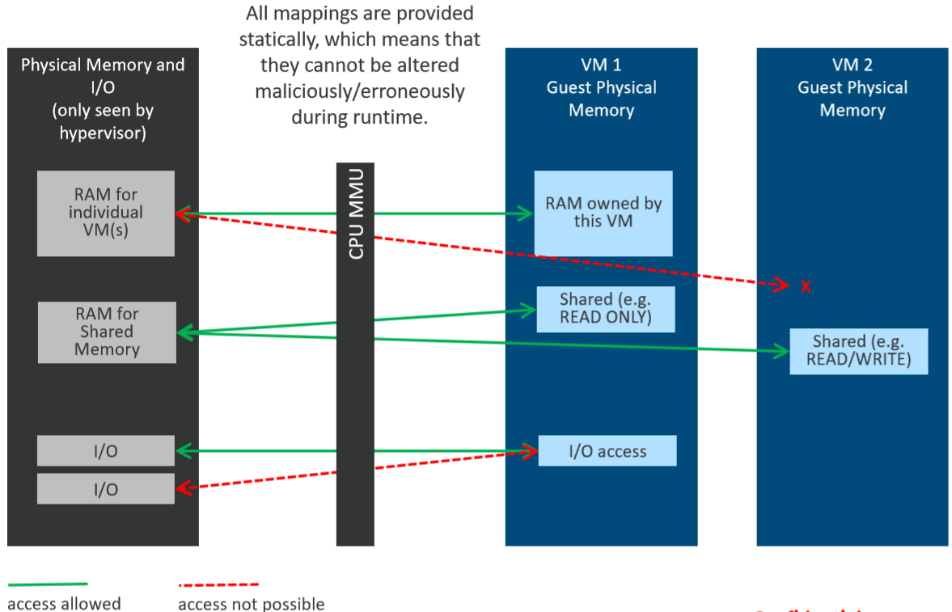
Memory Separation
Virtualization Security

Slide 15
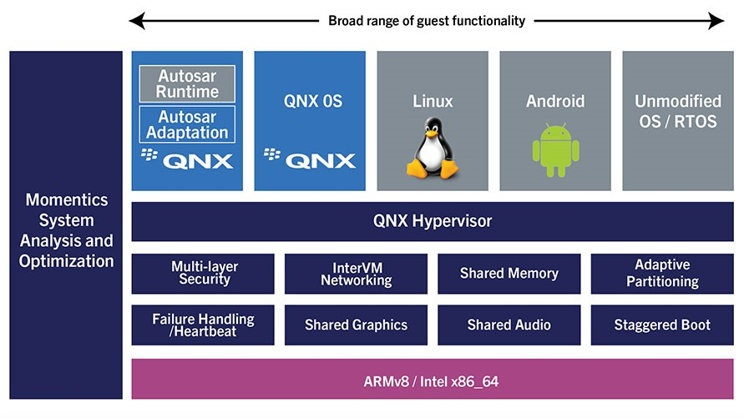
Features
QNX
Type 1 Hypervisor
Safety certification pedigree
Virtual CPU model
Pin to cores or share cores based on priority
Adaptive partitioning. Allows for CPU guarantees of guest runtime
64-bit and 32-bit guests: QNX, Linux, Android, RTOS
Shared memory with triggering
VirtIO (1.0) device sharing
TAP(Test Access Point) and peer-to-peer networking with bridging
Failure detection and restart of guests
Virtual watchdog for guest integrity checking
Low overhead (typical < 2%)
Graphical tools for analysis and debug

Slide 16
Support Platform
QNX
The QNX Hypervisor makes full use of all virtualization capabilities offered by the hardware
Support X86_64 and Arm64
Platform: Qualcomm 820/8155/61xx, Renesas H3/M3, Intel Apollo Lake, NXP i.MX8QM
If we have new SoCs requirements, we may discuss how to support them case by case with QNX

Slide 17
Conclusion
Hypervisor
Similarity of QNX, Multivisor and Coqos
Type-1
Paravirtualization
Small in footprint, high performance, very low overhead (< 2%-5%)
Similar technologies for device handling
ISO 26262 ASIL B or higher
Difference
Multivisor and QNX is RTOS in nature; no dedicated guest OS for critical software
Coqos is a pure hypervisor; critical software is running in guest OS as other software in generic purpose guest OS
Multivisor doesn’t support QNX; QNX doesn’t support Integrity OS; Coqos doesn’t support both
Other details such schedule policy, failure detection, SOC support…
There is no clear criteria to decide which hypervisor has advantage other the others. It is up to individual project and tier1 to select the most suitable hypervisor.

